Slide 1

Normalization Techniques
in Database Design (PostgreSQL)
Efficient Database Structuring for Data Integrity
Presented by Hamim

Slide 2



What is Database Normalization?
Normalization is the process of structuring a relational database in accordance with a series of so-called "normal forms" to reduce data redundancy and improve data integrity.
Minimize Redundancy
This systematic approach ensures that data dependencies are sensible and logically stored.
Avoid storing the same piece of information multiple times across the database.
PostgreSQL, as a robust object-relational database system, thrives on well-normalized schema designs for optimal performance and reliability.
Enhance Integrity
Ensure consistency and accuracy of data, minimizing the risk of anomalies.

Slide 3




Core Objectives of Normalization
Structuring a database is a strategic task aimed at making the system stable, scalable, and manageable.
Ensure Logical Dependencies
Eliminate Data Duplication
Make sure that attributes only depend on the primary key, or other keys where appropriate.
Prevent duplicate entries, saving storage space and ensuring a single source of truth.
Improve Database Performance
Simplify Queries and Updates
Reduce the need for complex joins and excessive I/O operations, making PostgreSQL faster.
A clean structure leads to simpler SQL queries and faster update operations.

Slide 4
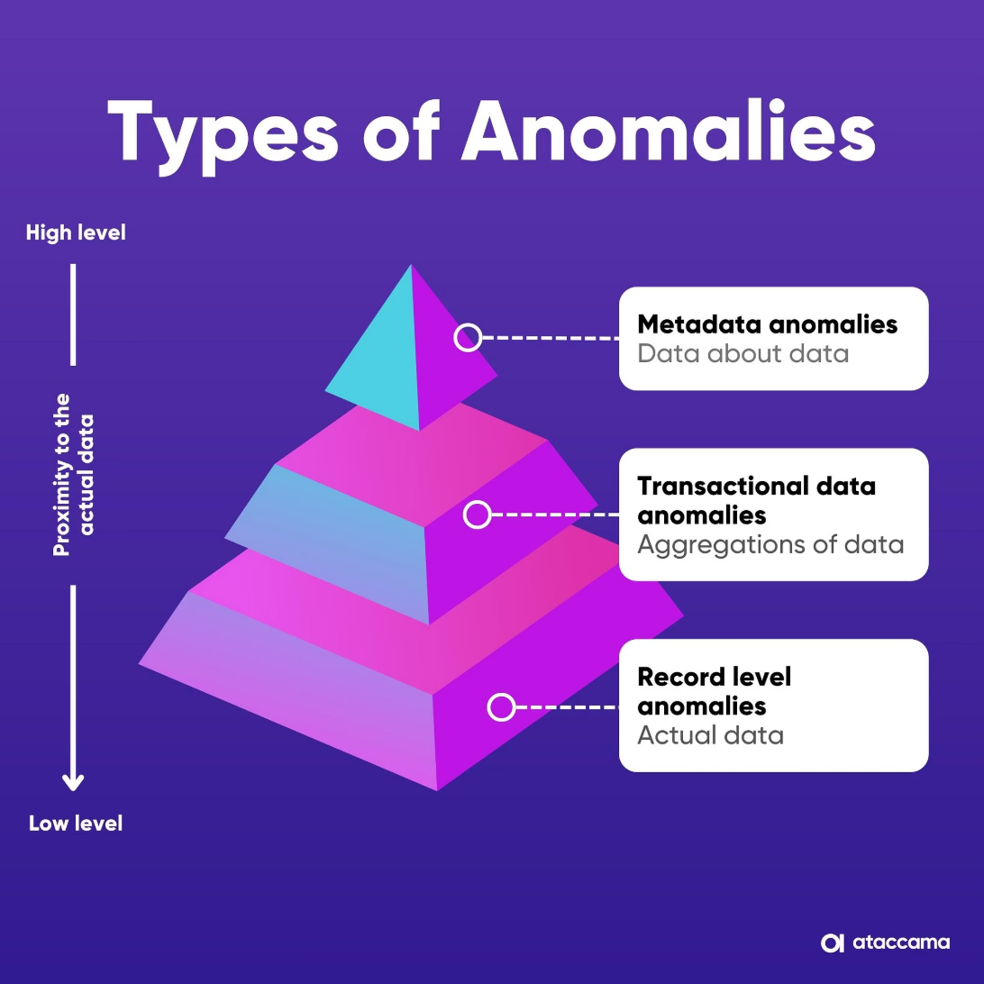
The Problem: Data Redundancy and Anomalies
An unnormalized table often leads to repetition and logical inconsistencies when modifying data.
Unnormalized Example Table
Imagine a table storing student enrollment where department information is repeated for every student in that department.
Student Name
Course
Dept ID
Dept Head
Alice
Math 101
D01
Dr. Smith
Alice
CS 202
D01
Dr. Smith
Betty
Art 300
D02
Ms. Jones
This repetition introduces three types of anomalies:
Update Anomaly: If 'Dr. Smith' changes, we must update multiple rows.
Insertion Anomaly: We cannot add a new Department Head until a student enrolls.
Deletion Anomaly: If we delete Betty, we lose the information about Dept D02.

Slide 5
Understanding Functional Dependencies (FD)
Functional Dependency (FD) is the key concept underlying normalization. It describes the relationship between attributes.
Definition: X → Y
Attribute X determines attribute Y if, for any valid database state, every X value is associated with exactly one Y value.
1
2
Simple Example
Composite Example
student_id → student_name, address
(order_id, product_id) → quantity
The student ID uniquely identifies the student's name and address.
The combination of order ID and product ID uniquely determines the quantity ordered.
Identifying the correct functional dependencies is the crucial first step in moving tables to higher normal forms.

Slide 6




The Normal Forms: A Progression of Clarity
Normalization involves progressing through a set of rules (Normal Forms) where each form eliminates more dependency problems than the last.
1NF: Atomicity
2NF: Full Dependency
Eliminate repeating groups and ensure atomic (single) values in each cell.
Must be 1NF + eliminate partial dependencies on a composite primary key.
3NF: No Transitivity
BCNF: Stronger Key Rule
Must be 2NF + eliminate transitive dependencies (non-key attributes depending on other non-key attributes).
Boyce–Codd Normal Form: Every determinant must be a candidate key.

Slide 7
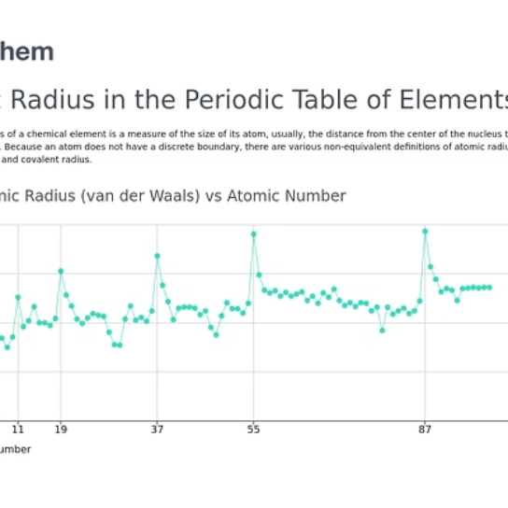
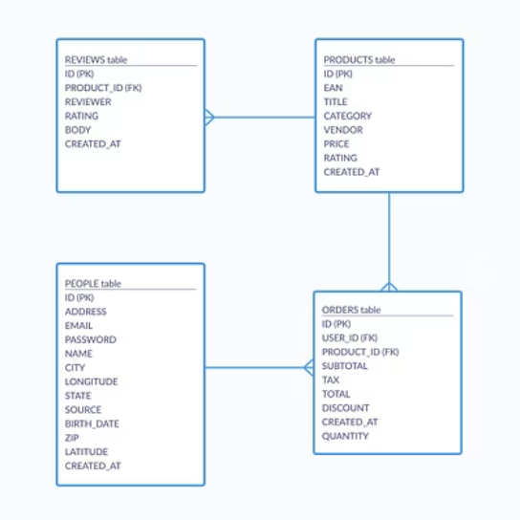
First Normal Form (1NF)
Achieving Atomicity
Rule: Each cell must contain a single, atomic value, and there should be no repeating columns.
PostgreSQL 1NF Table Structure
CREATE TABLE student_courses ( student_id INT, course TEXT, -- Primary key is composite (student_id, course) PRIMARY KEY (student_id, course) );
The main violation of 1NF is having multiple values stored in one column, such as a comma-separated list of courses.
Before (Violation): One row for John lists three courses: "DB, Java, Web".
After (1NF Compliant): Multiple rows are used to represent the relationship.

Slide 8
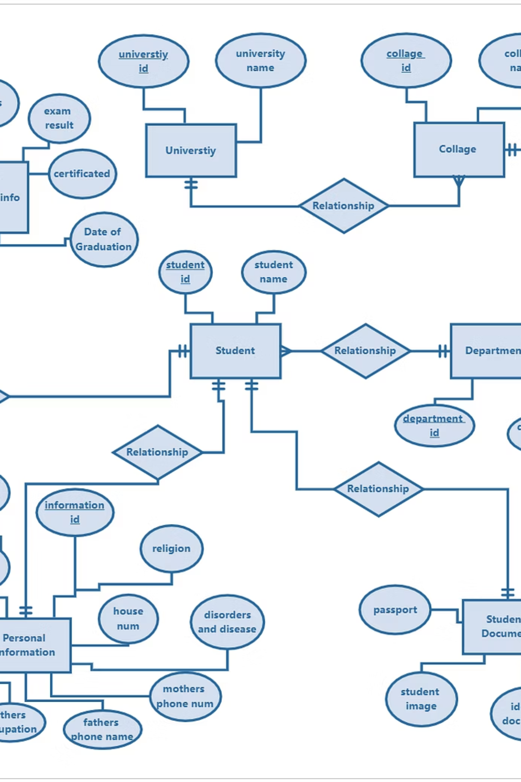
Second Normal Form (2NF)
Eliminating Partial Dependencies
Rule: Must be in 1NF, and all non-key attributes must be fully dependent on the composite primary key.
Example: Splitting Tables
Instead of one large table, we now have:
-- 1. Table for Student InformationCREATE TABLE students ( student_id SERIAL PRIMARY KEY, student_name TEXT);-- 2. Table for Enrollment/RelationshipCREATE TABLE enrollments ( student_id INT REFERENCES students(student_id), course_id INT REFERENCES courses(course_id), PRIMARY KEY (student_id, course_id));
A partial dependency occurs when a non-key attribute depends on only part of a composite key.
To fix this, we split the original table into two separate tables, ensuring non-key attributes only rely on their full key.

Slide 9
Third Normal Form (3NF) and BCNF
These forms address dependencies between non-key attributes, further refining the database structure.
3NF: Eliminating Transitive Dependencies
Rule: Must be in 2NF, and no non-key attribute is dependent on another non-key attribute.
Problem Example: student_id → department_id → department_name
The non-key attribute (department_name) depends transitively on the primary key (student_id). The fix is to separate the transitive dependency into a dedicated Departments table.
BCNF: Boyce-Codd Normal Form
Rule: Every determinant (attribute or set of attributes that determines others) must be a candidate key.
BCNF is a slightly stricter version of 3NF, mainly relevant when a table has multiple overlapping candidate keys. Achieving 3NF usually means you are very close to BCNF.
-- Separate Department Data for 3NFCREATE TABLE departments ( dept_id CHAR(3) PRIMARY KEY, dept_name TEXT);

Slide 10
Advantages and Practical Considerations
Normalization offers significant long-term benefits, but there are scenarios where strict adherence can be detrimental.
Normalization Benefits
1
Reduces Storage Space
Improves Data Integrity and Consistency
Facilitates Future Database Modifications and Scaling
2
When to Denormalize
In situations like data warehousing or reporting systems, denormalization might be used to improve read performance by minimizing joins.
PostgreSQL features like Indexing and Materialized Views can also help mitigate performance issues without compromising normalization integrity.
“Normalization is not just theory — it’s the foundation of clean database design.”
Thank you for your attention!

